Slide 1
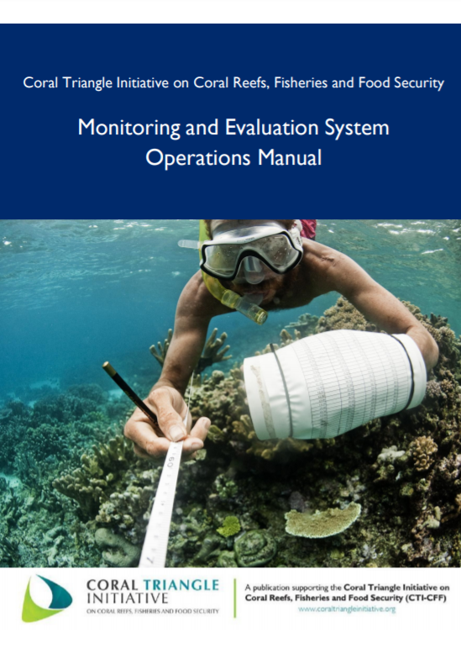
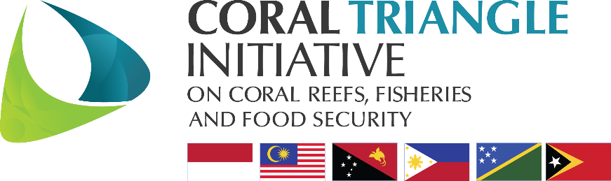
online Webinar:
Introduction to
Monitoring and Evaluation (M&E)
Revisiting the Monitoring and Evaluation System Operations Manual
Luz Teresa Baskinas
WWF Philippines, Vice President for Project Development
Member of the CTI CFF MEWG

Slide 2
Outline of the Presentation
Background on The Coral Triangle Initiative on Coral Reefs, Fisheries, and Food Security (CTI-CFF)
CTI-CFF Monitoring and Evaluation Working Group (MEWG)
The M&E Framework
The M&E System
Communicating the M&E

Slide 3
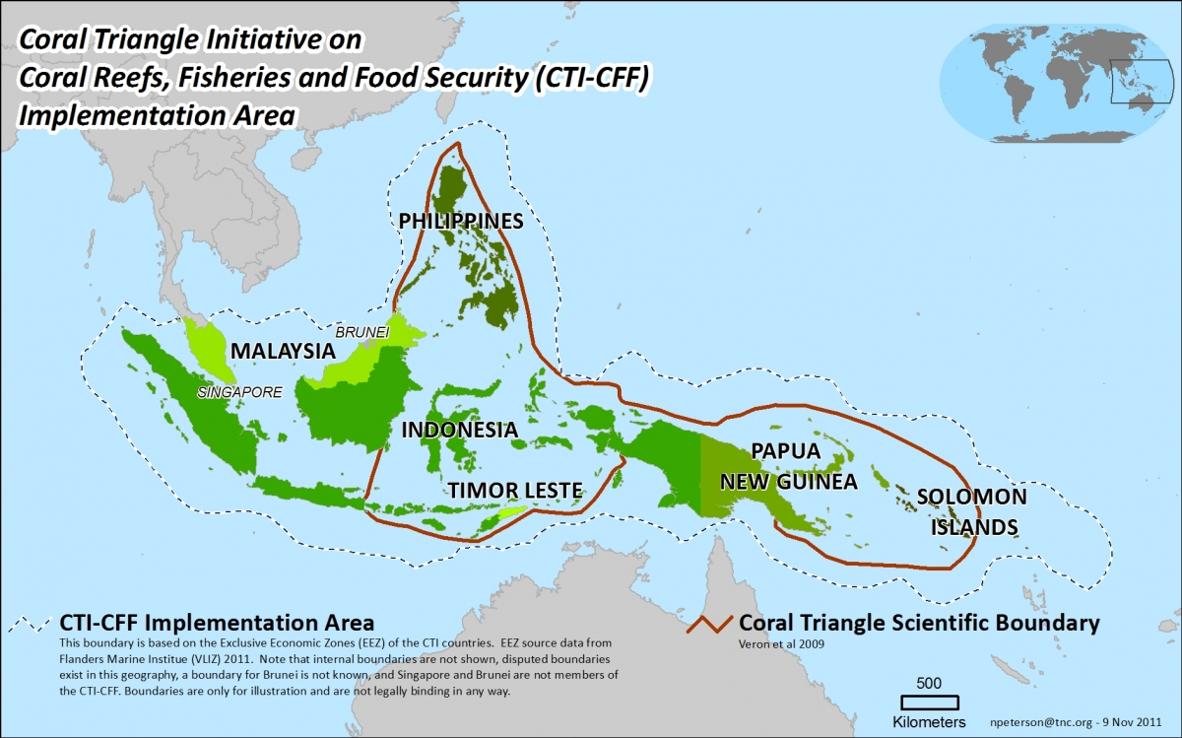
Background on the (CTI-CFF)

Slide 4
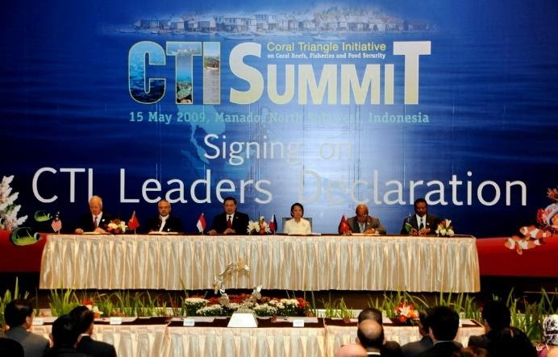
Background on the (CTI-CFF)
a multilateral partnership of six countries working together to sustain marine and coastal resources by addressing crucial issues such as food security, climate change and marine biodiversity

Slide 5
Background on the (CTI-CFF)
CTI-CFF Regional Plan of Action (CTI RPOA) to safeguard the region’s marine and coastal biological resources.
The RPOA has five (5) goals:
strengthening the management of seascapes;
promoting an ecosystem approach to fisheries management;
establishing and improving effective management of marine protected areas;
improving coastal community resilience to climate change; and
protecting threatened species.

Slide 6
Functions of the CTI-CFF Monitoring and Evaluation Working Group (MEWG):
Provides guidance to the CT6 to create a M&E System.
Gives technical inputs and recommendations to the Regional Secretariat and the National Coordinating Committees in achieving the over-arching goals that have been set out in the Regional Plan of Action.
Coordinates and assists the TWGs on the five goals of the RPOA, as well as bringing in partners and experts to help these five TWGs develop and track measures for their goals.
Coordinates with the CTI Regional Secretariat to communicate progress through the preparation of the regional State of the Coral Triangle Report as well as other reports and material.

Slide 7
M&E WG Workshops and Meetings
2008:
SOM 2, Manila (October)
The task is to develop the set of indicators to measure
achievement of RPOA goals and targets
2009:
SOM 3, Port Moresby (March)
SOM 4, Kota Kinabalu
The MEWG presented the initial set of proposed RPOA indicators to the SOM
2010:
SOM 6, Manado
The MEWG continued to develop the indicators through regional exchanges and workshops, bringing together the CTI-CFF countries, the interim Regional Secretariat and technical resource persons
2011:
SOM 7, Jakarta
2012:
Workshops, Manila & Jakarta
SOM 8, Jakarta
April 2013:
Workshop, Manila (M&E Manual development)

Slide 8
M&E System is described in Operations Manual and includes…
M&E Framework
Indicators
Benchmarks
Roadmap
Process flow
Preliminary capacity assessment
OVERALL PURPOSE: Track progress of CTI-CFF towards goals in the Regional Plan of Action using indicators that are measurable

Slide 9
The M&E Framework
The M&E framework presents the short-term and long-term measurable targets and goals of the CTICFF. It describes direct causal relationships between the incremental results of key activities to the overall achievement of the RPOA goals.
It has four essential components:
Activities – the activities carried out to achieve the targets of the 5 RPOA goals.
Outputs – the immediate results achieved through the execution of the activities.
Outcomes – the set of short-term or intermediate results achieved by through the execution of the activities.
Impacts– the long-term effects, or end results achieved by the 5 RPOA goals.

Slide 10
Two higher level outcomes are measured by RPOA indicators and additional outcome indicators.
Impact: Improvement in the affordability, availability and quality and safety of food coming from coastal and marine resources
RPOA outcomes for each country roll into a higher regional outcome.
Third higher level outcome, the Impact of the CTI on the people of the six countries. Most indicators are embedded in RPOA outcomes
Outcomes showing final success of RPOA
Higher level outcome 1:
Coral reef ecosystem integrity and services maintained.
Higher level outcome 2:
Fish stocks improved and sustained.
Outcome Indicators
Outcome Indicators
Outputs showing progress against RPOA
Each goal has a set of indicators according to the RPOA targets (outputs) and RPOA goals (outcomes)
Output Indicators
Priority Seascapes
CCA
MPAs
EAFM
Endangered Species
Notes:
This is the M&E framework: The indicators have been built on the five goals of the RPOA and their targets. The indicators are result-based, which means they report the results as opposed to actions.
The higher level outcome 1 and 2 were defined to that the several of the regional indicators roll up into them.
The impact and higher level outcomes have not been finalized.

Slide 11
Impact: Improvement in the affordability, availability and quality and safety of food coming from coastal and marine resources
Impact
Higher level outcome indicators
Coral reef ecosystem integrity and services maintained.
Condition of coral reefs
Extent of mangroves and seagrass
Fish biomass
Coral reef ecosystem integrity and services maintained.
Total regional area of coral reefs and associated habitats in fully protected (no take) areas.
Outcome indicators
3.1.2 Percent/Area of total marine habitat are in marine protected or managed area
3.1.3 Percent/area of each major marine and coastal habitat type in strictly protected “no-take replenishment zones”
Output indicators
3.1.1 CTMPAs Framework developed and adopted by CT6
3.1.5 Percent/Area of marine protected/ managed areas included in CTMPAs
Goals
Goal 3: Marine Protected areas established and effectively managed
Notes:
Example of the M&E framework using the Goal 3: Marine Protected areas established and effectively managed.

Slide 12
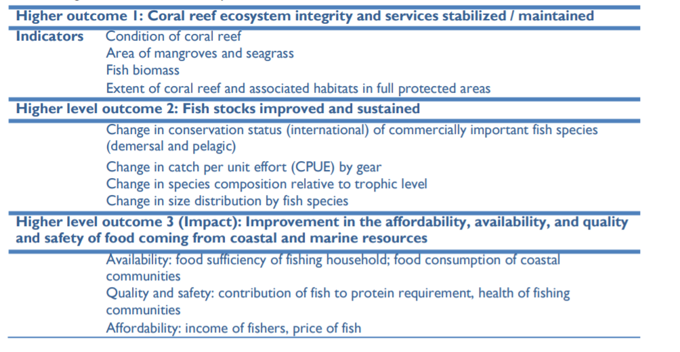
Higher level outcomes and impacts indicators of the CTI-CFF

Slide 13
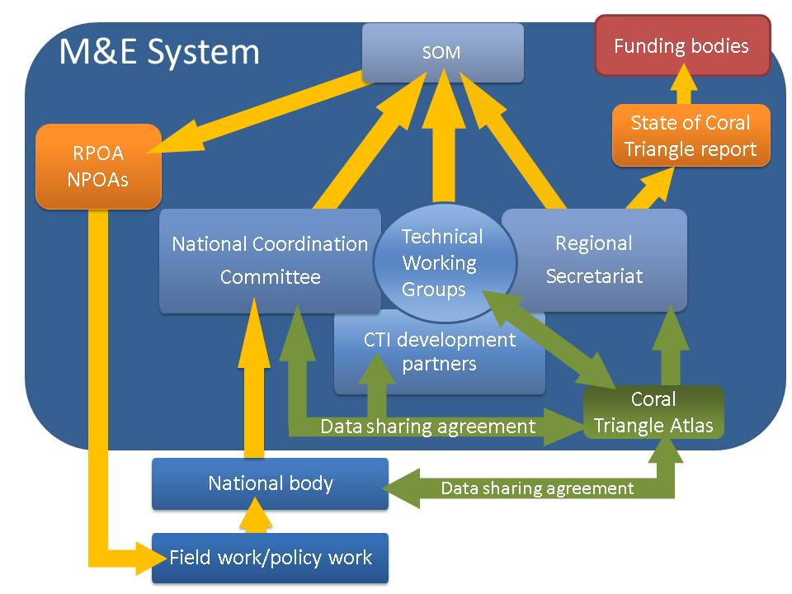
The M&E System in place – Roles, Reporting and Accountability
Notes:
Overview of the roles of each of the entities in the M&E System.
The Coral Triangle Atlas plays a central role in the system by collecting data that is directly measured at the regional level, compiling data from the six countries into regional measures, serving as an intermediary link between organizations outside of the CT region and the TWGs, and providing analysis to the TWGs, NCCs and the Regional Secretariat.
The CTI development partners, NCCs, TWGs and Regional Secretariat work in close collaboration to analyze, endorse and make recommendations to the SOM according to the measures obtained every year.

Slide 14
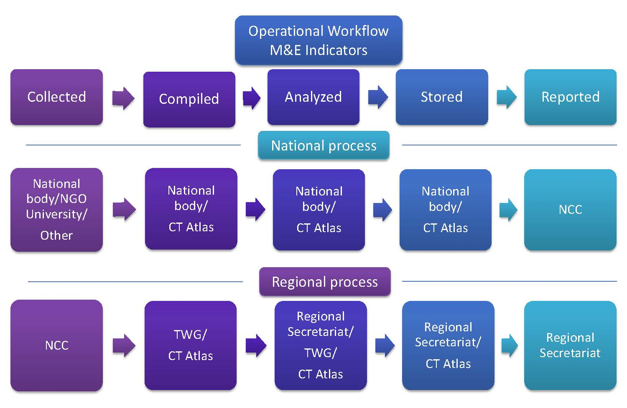
The M&E System Operational Work Flow
Notes:
The data pathway is a key tool to map who will be responsible, and even more importantly, who will be accountable for each step of the indicator: collect, measure, compile, analyze, store and report. It can also serve as a means of information for the entities that have been identified in the pathway to ensure their collaboration.
Starting with the field at the national level to the data compiled, analyzed, stored and reported, we can see that different entities are responsible for transferring the data to the NCC so it can be compiled with the other national data as a regional indicator. The NCC has a pivotal role since it is responsible for this intermediate link.
At the regional level, the same process (compiling, analyzing and storing) is supported by the TWGs, the CT Atlas and the Regional Secretariat.

Slide 15
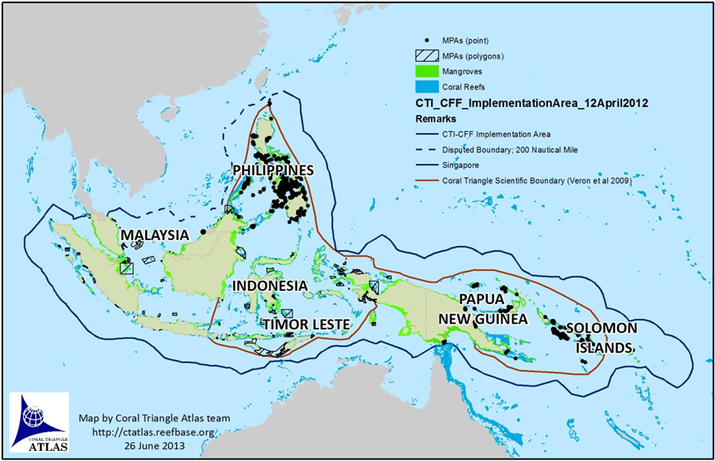
Coral Triangle Atlas database 2013--MPAs in the Coral Triangle (>1900)

Slide 16
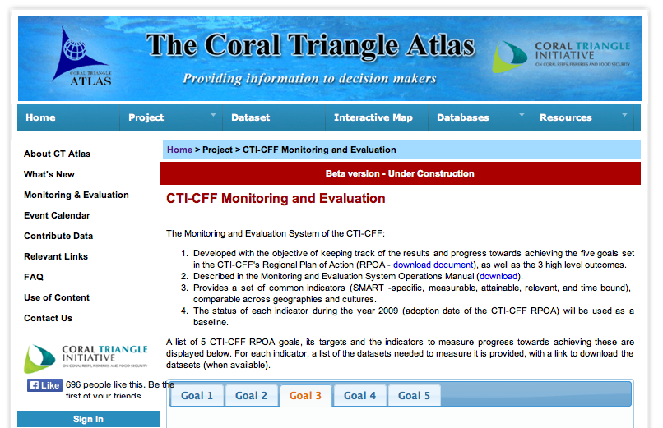

Slide 17
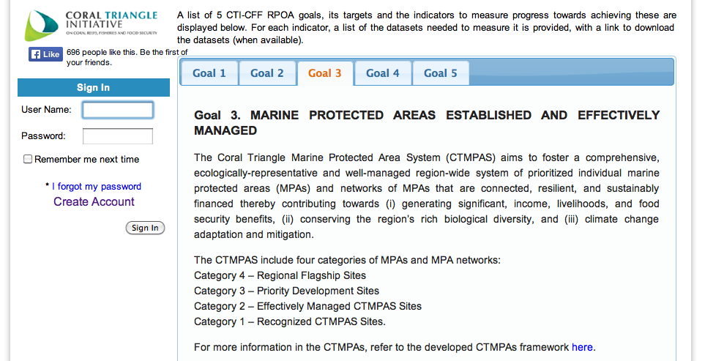

Slide 18
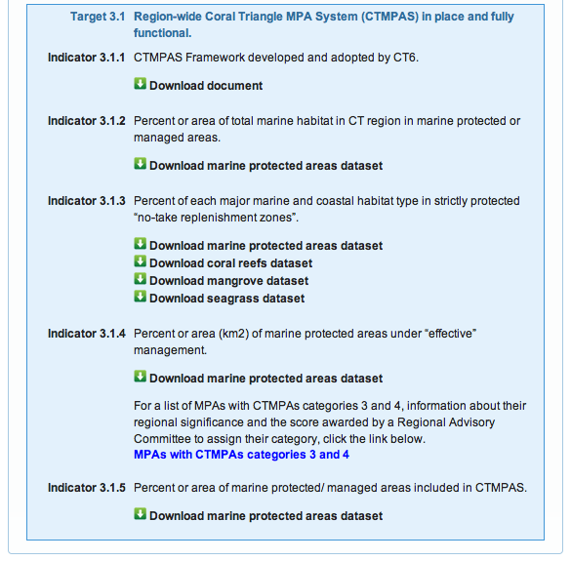

Slide 19
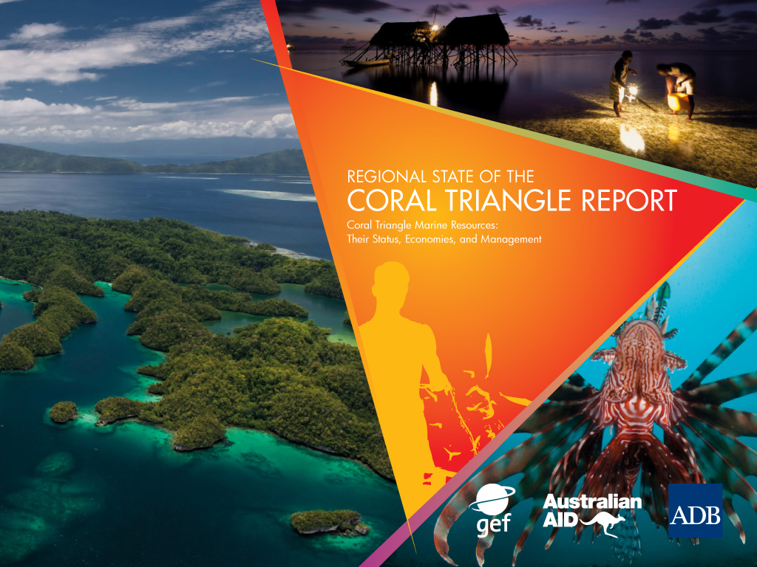
Communicating the M&E
the CTI-CFF website (http://www.coraltriangleinitiative.org)
Regional State of the Coral Triangle Report

Slide 20

Thank you
http://www.coraltriangleinitiative.org/sites/default/files/resources/ME%20%20Operations%20Manual_29April_2014_FINAL_0.pdf

